Slide 1


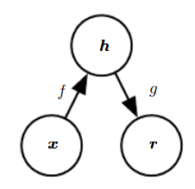
Unsupervised learning with
Autoencoders
Mengdie Huang
October 29, 2020

Slide 2








Background
Motivation
Overview
Model
Application Example
Conclusion

Slide 3
Background
Keywords
Probabilistic model
Unsupervised
learning
Autoencoder
Sparse AE
Denoising AE
Contractive AE
Inference
Posterior probability
Maximum likelihood
Latent variable
/*Reference*/

Slide 4
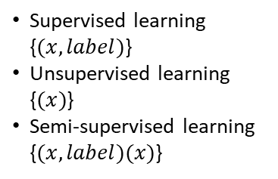
Background
Keywords
Does not require labels
Probabilistic model
Unsupervised
learning
Autoencoder
Sparse AE
Denoising AE
Contractive AE
Inference
Posterior probability
Maximum likelihood
Supervised learning
{$(x,label)$}
Unsupervised learning
{$(x)$}
Semi-supervised learning
{$(x,label)(x)$}
Latent variable
/*Reference*/

Slide 5


Background
What is the autoencoder?
As close as possible
NN
Encoder
NN
Decoder
vector
Embedding, Latent Representation, Latent Code, Latent variable
/*Reference*/Reducing the Dimensionality of Data with Neural Networks, G. E. Hinton*, R. R. Salakhutdinov, Science 28 Jul 2006

Slide 6
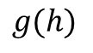
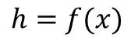
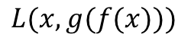
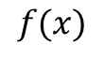
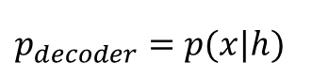
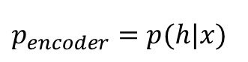
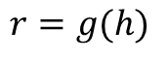
Background
What is the autoencoder?
Main idea
Copy its input to its output
Loss function
$$L(x,g(f(x)))$$
As close as possible
$$f(x)$$
$$h=f(x)$$
$$g(h)$$
$$r=g(h)$$
NN
Encoder
NN
Decoder
vector
$$p_{encoder}=p(h|x)$$
$$p_{decoder}=p(x|h)$$
Embedding, Latent Representation, Latent Code, Latent variable
/*Reference*/Reducing the Dimensionality of Data with Neural Networks, G. E. Hinton*, R. R. Salakhutdinov, Science 28 Jul 2006

Slide 7




Background
Famous quotes
“We expect unsupervised learning to become far more important in the longer term. Human and animal learning is largely unsupervised: we discover the structure of the world by observing it, not by being told the name of every object.”
– LeCun, Bengio, Hinton, Nature 2015
As I've said in previous statements: most of human and animal learning is unsupervised learning. If intelligence was a cake, unsupervised learning would be the cake, supervised learning would be the icing on the cake, and reinforcement learning would be the cherry on the cake. We know how to make the icing and the cherry, but we don't know how to make the cake.
- Yann LeCun, March 14, 2016 (Facebook)
/*Reference*/

Slide 8

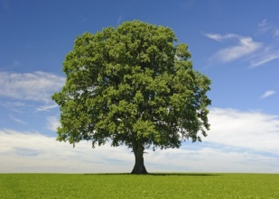
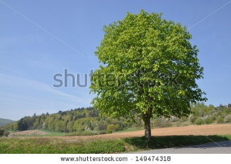
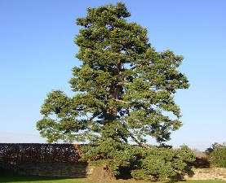
Background
Where unsupervised learning can be used in?
Dimension Reduction
Linear Dimension Reduction
Unsupervised learning only have function input
Generation
Unsupervised learning only have function output
function
function
Input random numbers
/*Reference*/

Slide 9
Background
Where unsupervised learning can be used in?
Dimension Reduction
Linear Dimension Reduction
Unsupervised learning only have function input
Generation
Unsupervised learning only have function output
function
function
Input random numbers
/*Reference*/

Slide 10

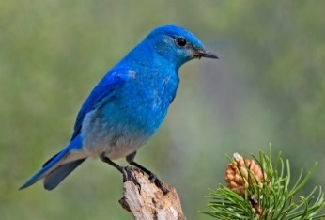

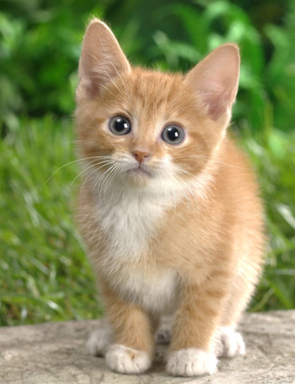
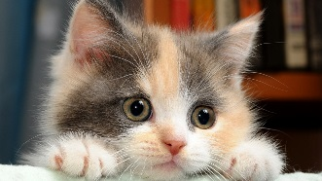

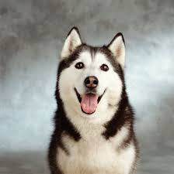
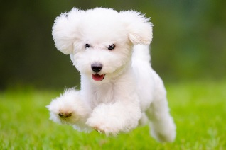
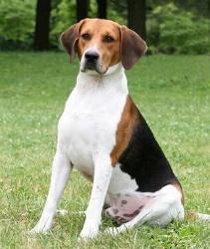
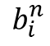
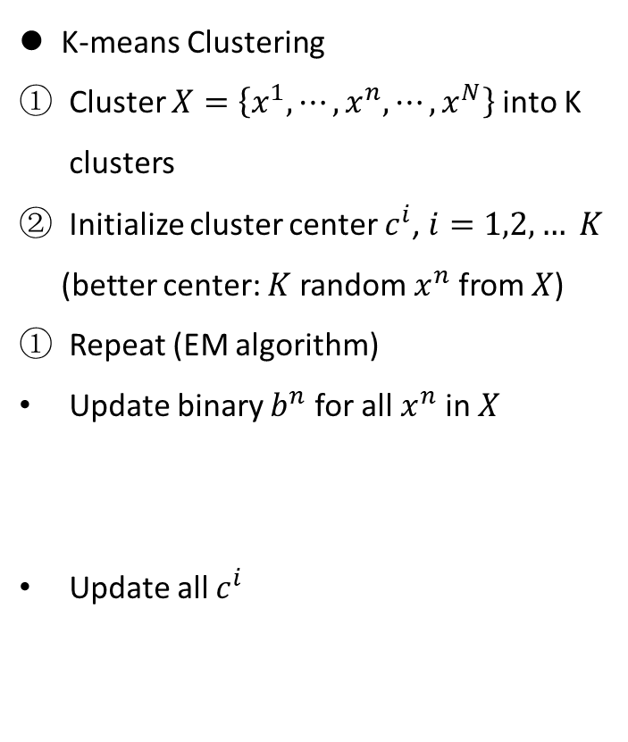
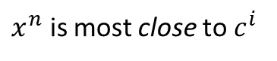
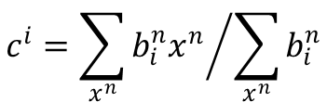
Background
Clustering
K-means Clustering
Cluster $X=\left\{x^{1},⋯,x^{n},⋯,x^{N}\right\}$into K clusters
Initialize cluster center $c^{i}$, $i=1,2, … K$
(better center: $K$ random $x^{n}$from 𝑋)
Repeat (EM algorithm)
Update binary $b^{n}$ for all $x^{n}$in 𝑋
Update all $c^{i}$
Cluster 3
Cluster 1
1
$x^{n}$ is most close to $c^{i}$
$$b_{i}^{n}$$
0
Otherwise
$$c^{i}={\sum_{x^{n}}{b_{i}^{n}x^{n}}}/{\sum_{x^{n}}{b_{i}^{n}}}$$
Cluster 2
/*Reference*/Pattern Recognition and Machine Learning, Chapter 9, Christopher M. Bishop, Springer Book 2006

Slide 11
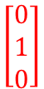
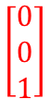
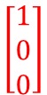
Background
Clustering
K-means Clustering
Cluster $X=\left\{x^{1},⋯,x^{n},⋯,x^{N}\right\}$into K clusters
Initialize cluster center $c^{i}$, $i=1,2, … K$
(better center: $K$ random $x^{n}$from 𝑋)
Repeat (EM algorithm)
Update binary $b^{n}$ for all $x^{n}$in 𝑋
Update all $c^{i}$
$$\left[\begin{aligned}0 \\ 0 \\ 1\end{aligned}\right]$$
Cluster 3
$$\left[\begin{aligned}1 \\ 0 \\ 0\end{aligned}\right]$$
Cluster 1
1
$x^{n}$ is most close to $c^{i}$
$$b_{i}^{n}$$
0
Otherwise
$$\left[\begin{aligned}0 \\ 1 \\ 0\end{aligned}\right]$$
$$c^{i}={\sum_{x^{n}}{b_{i}^{n}x^{n}}}/{\sum_{x^{n}}{b_{i}^{n}}}$$
Cluster 2
/*Reference*/Pattern Recognition and Machine Learning, Chapter 9, Christopher M. Bishop, Springer Book 2006

Slide 12
Background
Clustering
K-means Clustering
Cluster $X=\left\{x^{1},⋯,x^{n},⋯,x^{N}\right\}$into K clusters
Initialize cluster center $c^{i}$, $i=1,2, … K$
(better center: $K$ random $x^{n}$from 𝑋)
Repeat (EM algorithm)
Update binary $b^{n}$ for all $x^{n}$in 𝑋
Update all $c^{i}$
$$\left[\begin{aligned}0 \\ 0 \\ 1\end{aligned}\right]$$
Cluster 3
$$\left[\begin{aligned}1 \\ 0 \\ 0\end{aligned}\right]$$
Open question:
how many clusters do we need?
HAC
Cluster 1
1
$x^{n}$ is most close to $c^{i}$
$$b_{i}^{n}$$
0
Otherwise
$$\left[\begin{aligned}0 \\ 1 \\ 0\end{aligned}\right]$$
$$c^{i}={\sum_{x^{n}}{b_{i}^{n}x^{n}}}/{\sum_{x^{n}}{b_{i}^{n}}}$$
Cluster 2
/*Reference*/Pattern Recognition and Machine Learning, Chapter 9, Christopher M. Bishop, Springer Book 2006

Slide 13
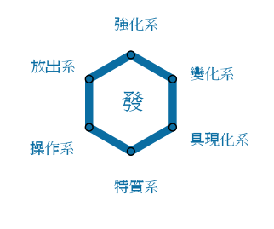
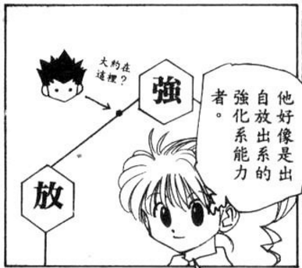
Background
Distributed Representation
Clustering (以偏概全，太粗燥)
Assign an object to one cluster
Distributed representation
A vector represents an object
Each dimension of the vector represents an attribute
小杰是
Attribute | Probability
强化系 | 0.70
放出系 | 0.25
变化系 | 0.05
操作系 | 0.00
具现化系 | 0.00
特质系 | 0.00
This is dimension Reduction
/*Reference*/Pattern Recognition and Machine Learning, Chapter 9, Christopher M. Bishop, Springer Book 2006

Slide 14
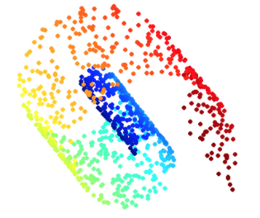
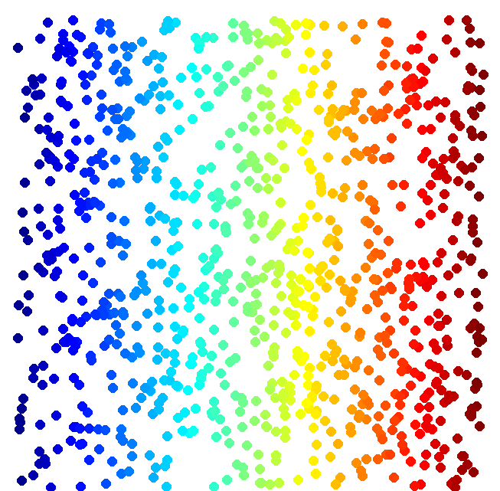
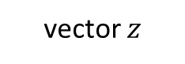
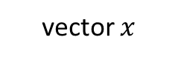
Background
Dimension Reduction
The dimension of the space to describe Data Distribution is wasteful
vector $x$
function
vector $z$
(High Dim)
(Low Dim)
Looks like 3-D
Actually, 2-D
/*Reference*/

Slide 15
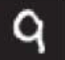
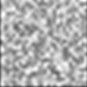
Background
Dimension Reduction
The dimension of the space to describe Data Distribution is wasteful
In MNIST, a digit is 28 x 28 dims
Most 28 x 28 dim vectors are not digits
3
3
3
3
3
-20。
-10。
0。
10。
20。
/*Reference*/

Slide 16
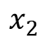
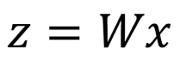
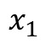
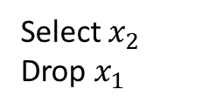
Background
Classical Methods for Dimension Reduction
Feature selection
Principle component analysis (PCA)
Linear function
vector $x$
function
vector $z$
(High Dim)
(Low Dim)
$$x_{2}$$
Select $x_{2}$
Drop $x_{1}$
$$z=Wx$$
$$x_{1}$$
/*Reference*/Pattern Recognition and Machine Learning, Chapter 12, Christopher M. Bishop, Springer Book 2006

Slide 17
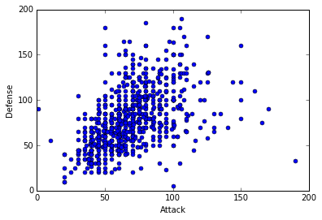
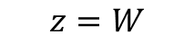
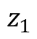
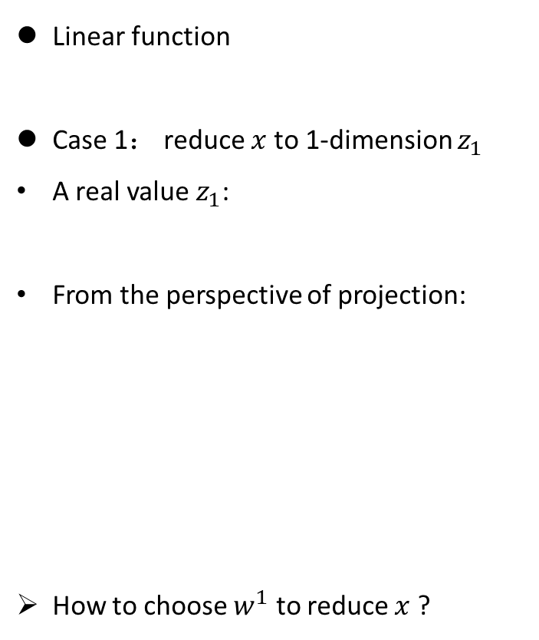
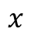
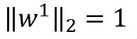
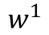
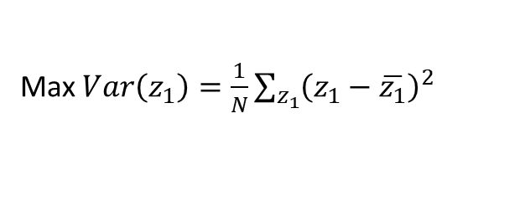
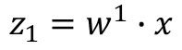
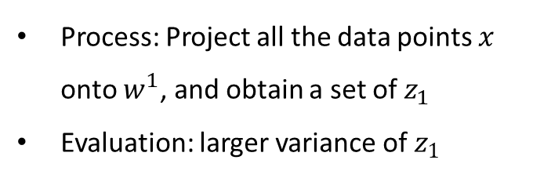
Background
Principle component analysis (PCA)
Linear function
Case 1： reduce $x$to 1-dimension $z_{1}$
A real value $z_{1}$:
From the perspective of projection:
How to choose $w^{1}$ to reduce $x$?
$$z=W$$
$$z_{1}=w^{1}∙x$$
$${\left\|w^{1}\right\|}_{2}=1$$
Large variance
$$x$$
Small variance
Process: Project all the data points $x$ onto $w^{1}$, and obtain a set of $z_{1}$
Evaluation: larger variance of $z_{1}$
$$w^{1}$$
$$z_{1}$$
Max $Var\left(z_{1}\right)=\frac{1}{N}\sum_{z_{1}}{{\left(z_{1}−\overline{z_{1}}\right)}^{2}}$
/*Reference*/Pattern Recognition and Machine Learning, Chapter 12, Christopher M. Bishop, Springer Book 2006

Slide 18
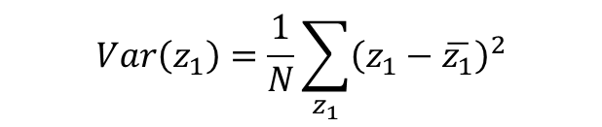
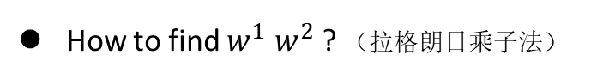
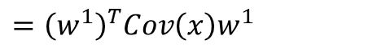












Background
Principle component analysis (PCA)
Linear function
Case 2： reduce $x$to 2-dimension [$z_{1}$ $z_{2}$]
Real value :
Add an orthogonal constraint to $W$:
How to find $w^{1}$ $w^{2}$ ? （拉格朗日乘子法）
$$z=W$$
Max $Var\left(z_{1}\right)=\frac{1}{N}\sum_{z_{1}}{{\left(z_{1}−\overline{z_{1}}\right)}^{2}}$
$$=\frac{1}{N}\sum_{x}{{\left(w^{1}∙x−w^{1}∙\overline{x}\right)}^{2}}$$
$$z_{1}=w^{1}∙x$$
$${\left\|w^{1}\right\|}_{2}=1$$
$$=\frac{1}{N}\sum{{\left(w^{1}∙\left(x−\overline{x}\right)\right)}^{2}}$$
$$z_{2}=w^{2}∙x$$
$${\left\|w^{2}\right\|}_{2}=1$$
$$Var\left(z_{1}\right)=\frac{1}{N}\sum_{z_{1}}{{\left(z_{1}−\overline{z_{1}}\right)}^{2}}$$
$$=\frac{1}{N}\sum{{\left(w^{1}\right)}^{T}\left(x−\overline{x}\right){\left(x−\overline{x}\right)}^{T}w^{1}}$$
$$Var\left(z_{2}\right)=\frac{1}{N}\sum_{z_{2}}{{\left(z_{2}−\overline{z_{2}}\right)}^{2}}$$
$$={\left(w^{1}\right)}^{T}\frac{1}{N}\sum{\left(x−\overline{x}\right){\left(x−\overline{x}\right)}^{T}}w^{1}$$
$$={\left(w^{1}\right)}^{T}Cov\left(x\right)w^{1}$$
$$w^{1}⊥w^{2}$$
$$w^{1}∙w^{2}=0$$
$$S=Cov\left(x\right)$$
/*Reference*/Pattern Recognition and Machine Learning, Chapter 12, Christopher M. Bishop, Springer Book 2006

Slide 19


Background
Principle component analysis (PCA)
Linear function
Case 2： reduce $x$to 2-dimension [$z_{1}$ $z_{2}$]
Real value :
Add an orthogonal constraint to $W$:
How to find $w^{1}$ $w^{2}$ ?
Lagrange multiplier method
Conclusion:
$w^{1}$ is the eigenvector of the covariance matrix $S=Cov(x)$ Corresponding to the largest eigenvalue $λ_{1}$
$w^{2}$ is the eigenvector of the covariance matrix $S=Cov(x)$ Corresponding to the 2nd eigenvalue $λ_{2}$
Gradient descent
See PCA as a
Neural network (NN)
$$z=W$$
$$z_{1}=w^{1}∙x$$
$${\left\|w^{1}\right\|}_{2}=1$$
$$z_{2}=w^{2}∙x$$
$${\left\|w^{2}\right\|}_{2}=1$$
$$Var\left(z_{1}\right)=\frac{1}{N}\sum_{z_{1}}{{\left(z_{1}−\overline{z_{1}}\right)}^{2}}$$
$$Var\left(z_{2}\right)=\frac{1}{N}\sum_{z_{2}}{{\left(z_{2}−\overline{z_{2}}\right)}^{2}}$$
$$z=\left[\begin{aligned}z_{1} \\ z_{2} \\ ⋮ \\ z_{K}\end{aligned}\right]=\left[\begin{aligned}{\left(w_{1}\right)}^{T} \\ {\left(w_{2}\right)}^{T} \\ ⋮ \\ {\left(w_{K}\right)}^{T}\end{aligned}\right]x$$
$$w^{1}⊥w^{2}$$
$$w^{1}∙w^{2}=0$$
/*Reference*/Pattern Recognition and Machine Learning, Chapter 12, Christopher M. Bishop, Springer Book 2006

Slide 20
























Motivation
Principle component analysis (PCA)
From another point of view
Basic component：28x28 pixel → vector $u^{i}$ $∈R^{28×28}$
If $K$ components： {$u^{1}$, $u^{2}$,…, $u^{K}$}
$c_{1}$=1
$c_{2}$=0
$c_{3}$= 1
$c_{4}$= 0
$c_{5}$= 1
…….
$$u^{1}$$
$$u^{2}$$
$$u^{3}$$
$$u^{4}$$
$$u^{5}$$
$$\left[\begin{aligned}1 \\ 0 \\ 1 \\ 0 \\ 1 \\ ⋮\end{aligned}\right]$$
$$≈$$
+
+
$$u^{1}$$
$$u^{3}$$
$$u^{5}$$
Component Weight $c=$ represents a digit image
$$\left[\begin{aligned}c_{1} \\ c_{2} \\ ⋮ \\ c_{K}\end{aligned}\right]$$
$$x≈c_{1}u^{1}+c_{2}u^{2}+⋯+c_{K}u^{K}+\overline{x}$$
component
/*Reference*/Pattern Recognition and Machine Learning, Chapter 12, Christopher M. Bishop, Springer Book 2006

Slide 21





Motivation
Principle component analysis (PCA)
From another point of view
Basic component：28x28 pixel → vector $u^{i}$ $∈R^{28×28}$
If $K$ components： {$u^{1}$, $u^{2}$,…, $u^{K}$}
Let the result of Linear combination
How to find the best K vector {$u^{1}$, $u^{2}$,…, $u^{K}$} to minimize the error ?
Define Reconstruction error
Object function
Conclusion: {$w^{1}$, $w^{2}$,…, $w^{K}$} is the component {$u^{1}$, $u^{2}$,…, $u^{K}$} minimizing $L$
$${\left\| (x−\overline{x})−\hat{x}\right\|}_{2}$$
$$L=\min_{\left\{u^{1},…,u^{K}\right\}}{\sum{{\left\|\left(x−\overline{x}\right)−\hat{x}\right\|}_{2}}}=\min_{\left\{u^{1},…,u^{K}\right\}}{\sum{{\left\|\left(x−\overline{x}\right)−\left(\sum_{k=1}^{K}{c_{k}u^{k}}\right)\right\|}_{2}}}$$
$$x≈c_{1}u^{1}+c_{2}u^{2}+⋯+c_{K}u^{K}+\overline{x}$$
component
$$x−\overline{x}≈c_{1}u^{1}+c_{2}u^{2}+⋯+c_{K}u^{K}=\hat{x}$$
$$z=\left[\begin{aligned}z_{1} \\ z_{2} \\ ⋮ \\ z_{K}\end{aligned}\right]=\left[\begin{aligned}{\left(w_{1}\right)}^{T} \\ {\left(w_{2}\right)}^{T} \\ ⋮ \\ {\left(w_{K}\right)}^{T}\end{aligned}\right]x$$
As close as possible
/*Reference*/Pattern Recognition and Machine Learning, Chapter 12, Christopher M. Bishop, Springer Book 2006

Slide 22
Motivation
Autoencoder
How to evaluate the performance of the code? What does the code should look like?
NN Encoder + NN decoder
Undercomplete Autoencoder
Usually <784
NN Encoder
NN Decoder
code
28 X 28 = 784
Learn together
Compact representation of the input object
Can reconstruct the original object
/*Reference*/

Slide 23











Motivation
Principle component analysis (PCA) → Autoencoder
Ignore $\overline{x}$ :
Output of the hidden layer: Code/ Embedding/ Latent Representation/ Latent Code
Latent representation
Minimize ${\left\| (x−\overline{x})−\hat{x}\right\|}_{2}$
Flaw: only have one hidden layer!
$$x−\overline{x}=x−0=x$$
Minimize ${\left(x−\hat{x} \right)}^{2}$
As close as possible
Component Weight
Encode
Decode
$$x$$
$$c$$
$$\hat{x}$$
$$W$$
$$include \text{\{}u^{1}\text{, }u^{2}\text{,…, }u^{K}\text{\}}$$
$$W^{T}$$
Input layer
One (linear) hidden layer
output layer
Called: Bottleneck layer
$$x=Wc+b$$
/*Reference*/Deep Learning, Chapter 13, Ian Goodfellow, Yoshua Bengio, Aaron Courville, 2017

Slide 24






Motivation
Autoencoder → Deep Autoencoder
Autoencoder can be deep
Deep Neural network
Use back propagation to train
Symmetric is not necessary
Hard to train Deep Autoencoder
Pre-training:
Initialize by RBM layer-by-layer
As close as possible
…
…
Layer
Layer
Output Layer
Input Layer
Layer
bottle
Layer
Layer
Layer
$$W_{2}^{T}$$
$$W_{1}$$
$$W_{2}$$
$$W_{1}^{T}$$
$$x$$
Code
$$\hat{x}$$
/*Reference*/Reducing the Dimensionality of Data with Neural Networks, G. E. Hinton*, R. R. Salakhutdinov, Science 28 Jul 2006

Slide 25


Model
Generative Performance (PCA VS. Deep Autoencoder)
Original Image
PCA
784
30
784
/*Reference*/Reducing the Dimensionality of Data with Neural Networks, G. E. Hinton*, R. R. Salakhutdinov, Science 28 Jul 2006

Slide 26


Model
Generative Performance (PCA VS. Deep Autoencoder)
Original Image
PCA
Deep Autoencoder
784
30
784
Increase dimension
784
1000
500
250
30
250
500
784
1000
Reduce dimension
/*Reference*/Reducing the Dimensionality of Data with Neural Networks, G. E. Hinton*, R. R. Salakhutdinov, Science 28 Jul 2006

Slide 27

Model
Generative Performance (PCA VS. Deep Autoencoder)
/*Reference*/Reducing the Dimensionality of Data with Neural Networks, G. E. Hinton*, R. R. Salakhutdinov, Science 28 Jul 2006

Slide 28

Model
Visualize 2-dimension Representation (PCA VS. Deep Autoencoder)
784
2
784
/*Reference*/Reducing the Dimensionality of Data with Neural Networks, G. E. Hinton*, R. R. Salakhutdinov, Science 28 Jul 2006

Slide 29
Model
Visualize 2-dimension Representation (PCA VS. Deep Autoencoder)
784
1000
500
250
2
250
500
784
1000
/*Reference*/Reducing the Dimensionality of Data with Neural Networks, G. E. Hinton*, R. R. Salakhutdinov, Science 28 Jul 2006

Slide 30
Model
Category
Autoencoder
Regularized Autoencoder
Sparse Autoencoder
Denoising Autoencoder
Generative Model With Latent Variable And Inference
Helmholtz Machine
Contractive Autoencoder
Variation Autoencoder
/*Reference*/

Slide 31





Motivation
Denoising Autoencoder (DAE)
As close as possible
$$c$$
$$x$$
$$x′$$
$$\hat{x}$$
Add noise
Encode
Decode
/*Reference*/Extracting and composing robust features with denoising autoencoders, Pascal Vincent, Yoshua Bengio, ICML2008

Slide 32







Model
Denoising Autoencoder (DAE)
Traditionally, autoencoders minimize
DAE instead minimizes
Corruption process
Train DAE to learn a reconstruction distribution
Step 1
Sample a training example $x$ from the training data
Step 2
Sample a corrupted version $\tilde{x}$ from
Step 3
Training example$(x,\tilde{x})$
Stochastic gradient descent
$$L(x,g(f(x)))$$
$$p_{reconstruct}(x|\tilde{x})$$
$$L(x,g(f(\tilde{x})))$$
$$C(\tilde{x}|x)$$
$$C(\tilde{x}|x)$$
$$p_{reconstruct}\left(x | \tilde{x}\right)=p_{decoder}(x|h=f(\tilde{x}))$$
/*Reference*/Extracting and composing robust features with denoising autoencoders, Pascal Vincent, Yoshua Bengio, ICML2008
Notes:
负对数似然进行近似最小化

Slide 33

Model
Denoising Autoencoder (DAE)
/*Reference*/Extracting and composing robust features with denoising autoencoders, Pascal Vincent, Yoshua Bengio, ICML2008

Slide 34





Model
Denoising Autoencoder (DAE) and Contractive Autoencoder (CAE)
DAE minimizes
CAE minimizes
Frobenius(弗罗贝尼乌斯) norm
(Matrix norm)
$$L(x,g(f(\tilde{x})))$$
$$L\left(x,g\left(f\left(x\right)\right)\right)+Ω\left(h,x\right)$$
$$Ω\left(h,x\right)=λ\sum_{i}{{||∇_{x}h_{i}||}^{2}}=λ\sum_{i}{{{||\frac{∂f(x)}{∂x}||}_{F}}^{2}}$$
Derivative
DAE tries to make the derivative of the reconstruction function r(x) small around the data points
a large derivative between the data points to map corrupted points back onto the manifold
/*Reference*/Extracting and composing robust features with denoising autoencoders, Pascal Vincent, Yoshua Bengio, ICML2008
Notes:
弗罗贝尼乌斯

Slide 35
Application Example
Text Retrieval (Autoencoder VS. LSA)
Vector Space Model
Encode a text into a vector with low dimension
Bag-of-word
Word string: “This is an apple”
Semantics are not considered: independent between words
this
1
query
is
1
a
0
an
1
…
document
apple
1
pen
0
/*Reference*/
Notes:
同义词和多义词如何导致传统向量空间模型检索精确度

Slide 36


Application Example
Text Retrieval (Autoencoder VS. LSA)
Use Autoencoder to consider semantics in Bag-of-word(document or query)
The documents talking about the same thing will have close code.
2
125
250
500
Latent Semantic Analysis (LSA): project documents to 2 latent vector
2000
Bag-of-word
/*Reference*/

Slide 37


Application Example
Similar Image Search (Autoencoder VS. Euclidean distance )
Use Euclidean distance in pixel intensity space.
/*Reference*/

Slide 38



Application Example
Similar Image Search (Autoencoder VS. Euclidean distance )
Use deep Autoencoder
8192
2048
1024
512
256
4096
32x32
code
/*Reference*/

Slide 39


Application Example
Similar Image Search (Autoencoder VS. Euclidean distance )
Use Euclidean distance in pixel intensity space.
Use deep Autoencoder
Retrieved using 256-dimension codes
/*Reference*/

Slide 40


Application Example
Pre-training Deep Neural Network (DNN)
Find a group of parameters to initialize the DNN
Target model: 10 class-Classifier
output
10
500
1000
784
$$\hat{x}$$
W1’
1000
1000
close
fix
W1
784
784
$$x$$
Input
Input
/*Reference*/

Slide 41

Application Example
Pre-training Deep Neural Network (DNN)
Find a group of parameters to initialize the DNN
Target model: 10 class-Classifier
output
10
$$\text{L}\text{(}\text{x}\text{,}\text{g}\text{(}\text{f}\text{(}\text{x}\text{)))}\text{+}λ\sum_{i}{|h_{i}|}$$
500
Sparse autoencoer
1000
784
$$\hat{x}$$
Add a regularization to the loss function
W1’
1000
1000
close
fix
W1
Overcomplete autoencoder
784
784
$$x$$
Input
Input
/*Reference*/

Slide 42



Application Example
Pre-training Deep Neural Network (DNN)
Find a group of parameters to initialize the DNN
Target model: 10 class-Classifier
output
10
500
1000
$${\hat{a}}^{1}$$
W2’
1000
close
1000
fix
W2
1000
1000
$$a^{1}$$
fix
W1
784
784
$$x$$
Input
Input
/*Reference*/

Slide 43




Application Example
Pre-training Deep Neural Network (DNN)
Find a group of parameters to initialize the DNN
Target model: 10 class-Classifier
output
10
1000
$${\hat{a}}^{2}$$
W3’
500
500
fix
W3
1000
1000
$$a^{2}$$
fix
W2
1000
1000
$$a^{1}$$
fix
W1
784
784
$$x$$
Input
Input
/*Reference*/

Slide 44

Application Example
Pre-training Deep Neural Network (DNN)
Find a group of parameters to initialize the DNN
Target model: 10 class-Classifier
output
10
10
Use backward propagation to finetune
W4
Random init W4
500
500
fix
W3
1000
1000
fix
W2
1000
1000
fix
W1
Use unlabeled data to pre-train w1,w2,w3, use labeled data to train w4
784
784
$$x$$
Input
Input
/*Reference*/

Slide 45



Conclusion
Overview
/*Reference*/

Slide 46
Conclusion
Keywords
Challenge
Probabilistic model
Unsupervised
learning
Autoencoder
Sparse AE
Denoising AE
Contractive AE
Inference
Posterior probability
Maximum likelihood
Statistical challenge
From generalization
Computational challenge
From high-dimensional distribution
Latent variable
/*Reference*/

Slide 47


Conclusion
Keywords
Challenge
$$p_{model}(x)$$
Probabilistic model
Unsupervised
learning
Autoencoder
Sparse AE
Denoising AE
Contractive AE
Inference
Posterior probability
Maximum likelihood
Statistical challenge
From generalization
Computational challenge
From high-dimensional distribution
Computational challenge
From inference
From normalization constants = partition function= $Z$
Latent variable
/*Reference*/

Slide 48


Conclusion
Keywords
Challenge
$$p_{model}(x)$$
Probabilistic model
Unsupervised
learning
Autoencoder
Sparse AE
Denoising AE
Contractive AE
Inference
Posterior probability
Maximum likelihood
Statistical challenge
From generalization
Computational challenge
From high-dimensional distribution
Computational challenge
From inference
From normalization constants = partition function= $Z$
Infer $p(b|a)$
Latent variable
Given joint distribution $f\left(a,b\right)$,$a$
Guess value of b
/*Reference*/

Slide 49


Conclusion
Keywords
Challenge
$$p_{model}(x)$$
Probabilistic model
Unsupervised
learning
Autoencoder
Sparse AE
Denoising AE
Contractive AE
Inference
Posterior probability
Maximum likelihood
Statistical challenge
From generalization
Computational challenge
From high-dimensional distribution
Computational challenge
From inference
From normalization constants = partition function= $Z$
Infer $p(b|a)$
Latent variable
Latent variable $h$
Given joint distribution $f\left(a,b\right)$,$a$
Guess value of b
Observed variable $x$
$p_{model}\left(x\right)=𝔼_{h}p_{model}(x|h)$
Distributed representations
Linear factor model
/*Reference*/

Slide 50

Conclusion
Keywords
Challenge
$$p_{model}(x)$$
Probabilistic model
Unsupervised
learning
Autoencoder
Sparse AE
Denoising AE
Contractive AE
Inference
Posterior probability
Maximum likelihood
Statistical challenge
From generalization
Computational challenge
From high-dimensional distribution
Computational challenge
From inference
From normalization constants = partition function= $Z$
Difficulty
Latent variable
Latent variable $h$
Compute${ p}_{model}(h|x)$
Compute $𝔼_{h}{ p}_{model}(h|x)$
Essential in Maximum likelihood
Observed variable $x$
$p_{model}\left(x\right)=𝔼_{h}p_{model}(x|h)$
Distributed representations
Linear factor model
/*Reference*/

Slide 51
Conclusion
Keywords
Challenge
$$p_{model}(x)$$
Probabilistic model
Unsupervised
learning
Autoencoder
Sparse AE
Denoising AE
Contractive AE
Inference
Exact inference
Approximate inference
Posterior probability
Maximum likelihood
Statistical challenge
From generalization
Computational challenge
From high-dimensional distribution
Computational challenge
From inference
From normalization constants = partition function= $Z$
Difficulty
Latent variable
Latent variable $h$
Compute${ p}_{model}(h|x)$
Compute $𝔼_{h}{ p}_{model}(h|x)$
Essential in Maximum likelihood
Observed variable $x$
$p_{model}\left(x\right)=𝔼_{h}p_{model}(x|h)$
Distributed representations
Linear factor model
/*Reference*/

Slide 52


Conclusion
Keywords
Challenge
$$p_{model}(x)$$
Probabilistic model
Unsupervised
learning
Autoencoder
Sparse AE
Denoising AE
Contractive AE
Inference
Exact inference
Approximate inference
Posterior probability
Maximum likelihood
Statistical challenge
From generalization
Computational challenge
From high-dimensional distribution
Computational challenge
From inference
From normalization constants = partition function= $Z$
$${ p}_{model}(h|x)←q(h|x)$$
Latent variable
Latent variable $h$
$\log{p(x;θ)}≥\text{ELBO}$
ELBO
$L=\left(x,θ,q\right)=\log{p_{model}\left(x;θ\right)}−D_{KL}(q(h|x)$
$$||p_{model}(h|x;θ))$$
Observed variable $x$
$p_{model}\left(x\right)=𝔼_{h}p_{model}(x|h)$
Distributed representations
Linear factor model
/*Reference*/

Slide 53


Conclusion
Keywords
Challenge
$$p_{model}(x)$$
Probabilistic model
Unsupervised
learning
Autoencoder
Sparse AE
Denoising AE
Contractive AE
Inference
Exact inference
Approximate inference
Posterior probability
Maximum likelihood
Statistical challenge
From generalization
Computational challenge
From high-dimensional distribution
Computational challenge
From inference
From normalization constants = partition function= $Z$
$${ p}_{model}(h|x)←q(h|x)$$
Latent variable
Latent variable $h$
$\log{p(x;θ)}≥\text{ELBO}$
ELBO
$L=\left(x,θ,q\right)=\log{p_{model}\left(x;θ\right)}−D_{KL}(q(h|x)$
$$||p_{model}(h|x;θ))$$
Observed variable $x$
$p_{model}\left(x\right)=𝔼_{h}p_{model}(x|h)$
Distributed representations
Linear factor model
$$θ_{ML}=\underset{θ}{arg max}{\prod_{i=1}^{n}{p_{model}(x^{(i)};θ)}}$$
$θ_{ML}=\underset{θ}{arg max}{\sum_{i=0}^{n}{\log{p_{model}(x^{\left(i\right)};θ)}}}=$ $\underset{θ}{arg max}{𝔼_{X∼p_{data}}[\log{p_{model}}(x)]}$
/*Reference*/

Slide 54


Conclusion
Keywords
Challenge
$$p_{model}(x)$$
Probabilistic model
Unsupervised
learning
Autoencoder
Sparse AE
Denoising AE
Contractive AE
Inference
Exact inference
Approximate inference
Posterior probability
Maximum likelihood
Statistical challenge
From generalization
Computational challenge
From high-dimensional distribution
Computational challenge
From inference
From normalization constants = partition function= $Z$
$${ p}_{model}(h|x)←q(h|x)$$
Latent variable
Latent variable $h$
$\log{p(x;θ)}≥\text{ELBO}$
ELBO
$L=\left(x,θ,q\right)=\log{p_{model}\left(x;θ\right)}−D_{KL}(q(h|x)$
$$||p_{model}(h|x;θ))$$
Observed variable $x$
$p_{model}\left(x\right)=𝔼_{h}p_{model}(x|h)$
Distributed representations
Linear factor model
$$θ_{ML}=\underset{θ}{arg max}{\prod_{i=1}^{n}{p_{model}(x^{(i)};θ)}}$$
Posterior $p(h|x)$
$θ_{ML}=\underset{θ}{arg max}{\sum_{i=0}^{n}{\log{p_{model}(x^{\left(i\right)};θ)}}}=$ $\underset{θ}{arg max}{𝔼_{X∼p_{data}}[\log{p_{model}}(x)]}$
After observation of $x$
Prior $p(h)$
/*Reference*/

Slide 55


Thanks
Mengdie Huang
Group AI Security
Lab Ruiyun
2020-10-28

